Slide 1
A Bilingual Approach to Speech Recognition and Translation: Hindi to English Conversion
V O X L I N G
Debanjan nanda Debayan datta Ayan maity

Slide 2
WHAT?
Speech-to-Text
Text Translation
Fusion of two core components
Hindi Audio to
Hindi Text
Hindi Text to
English Text

Slide 3
WHY?
Language Barrier Reduction: Bridging the gap for non-English speakers and enhancing in real time translation.
Accessibility: Provides an easy way for non-native Hindi speakers to access content available in Hindi.
Common Ground for Communication: Native Hindi speakers often encounter challenges when interacting in non-Hindi-speaking regions.
Automated Translated System: Highly useful in several industries like Tourism, Service Centre and Media.
Research & Development: Given that Hindi is considered a low-resource language compared to English and Mandarin, our project will foster research and development in this area.

Slide 4
HOW?

Slide 5
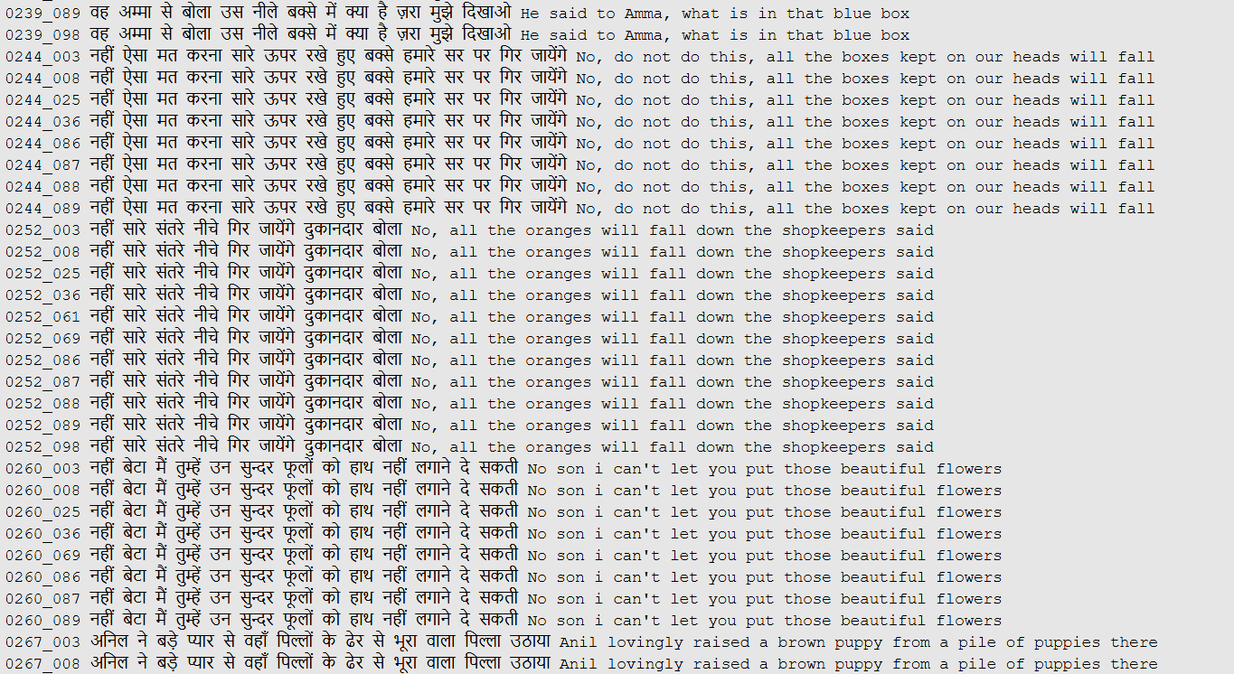
Model 1: Hindi Speech → Hindi Text
Dataset 1 (actually contains first 3 columns)
Source: OpenSLR
English Text is manually collected using Google Translate
Number of rows
99925 (Train)
3843 (Test)

Slide 6
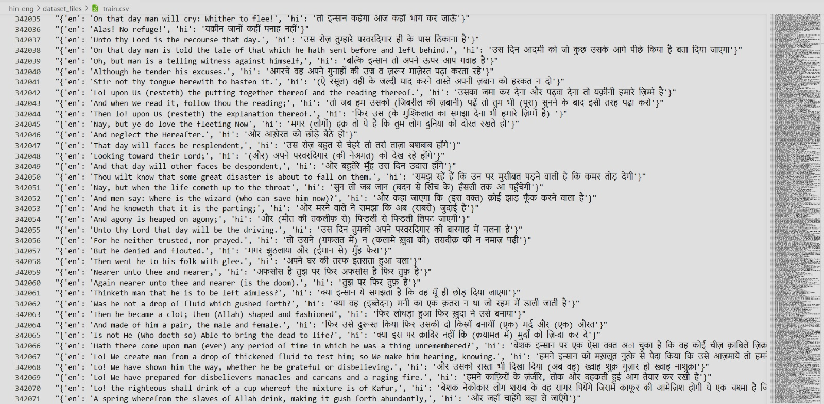
Model 2: Hindi Text → English Text
Dataset 2
The data available at https://www.clarin.eu/resource-families/parallel-corpora
1,27,607 rows

Slide 7
ID
HindSpeech
HindText
EngText
MODEL 1
Hindi Audio
Input
Intermediate
Predicted
HindText
comparison
Predicted
EngText
Output
MODEL 2
HindText
EngText

Slide 8
WORK PLAN & TIMELINE
Task | start | finish
Data Collection | 20-08-2024 | 26-08-2024
Literature Survey | 27-08-2024 | 14-09-2024
Data Preprocessing | 23-09-2024 | 2-10-2024
Model 1 Training | 2-10-2024 | 20-10-2024
Model 2 Training | 7-10-2024 | 27-10-2024
Evaluation and Validation | 27-10-2024 | 29-11-2024
Error Analysis and Optimization | 29-11-2024 | 05-11-2024
System Integration | 05-11-2024 | 15-11-2024
Final Testing and Validation | 15-11-2024 | 20-11-2024

Slide 9
Literature Survey
CoVoST: A Diverse Multilingual Speech-to-Text Translation Corpus by Changhan Wang, Juan Pino, Anne Wu, Jiatao Gu
Used Models and Work:
The authors created CoVoST, a dataset for speech-to-text translation from 11 languages into English, using the Common Voice corpus.
They used Transformer models with 3 encoder and decoder layers for ASR, MT, and ST, focusing on end-to-end multilingual models.
Results:
The ASR models performed best for French (WER: 24.6%) and German (WER: 40.9%) due to more data.
In MT, French achieved the highest BLEU score of 29.8, while Turkish and Swedish had much lower scores.
CoVoST 2 and Massively Multilingual Speech-to-Text Translation by Changhan Wang, Anne Wu, Juan Pino
Used Models and Work:
The authors created CoVoST 2, a large dataset for speech-to-text (ST) translation from 21 languages into English and 15 languages from English.
They used Transformer models for Automatic Speech Recognition (ASR), Machine Translation (MT), and Speech Translation (ST), providing both monolingual and multilingual baselines.
Results:
Multilingual models performed better, especially for languages with fewer resources.
For example, the BLEU score for French to English was 38.0, while it was much lower (0.3) for low-resource languages like Tamil and Japanese.

Slide 10
Literature Survey
Incorporating BERT into Neural Machine Translation by Jinhua Zhu, Yingce Xia.
Used Models and Work:
First approach - Initialized the encoder of NMT with a pre-trained BERT model and then fine-tuned NMT.
Second approach - Proposed a BERT fused model that integrates BERT-extracted representations into each layer of the NMT model’s encoder and decoder using attention mechanisms.
Results:
Contextual embeddings outperformed fine-tuning.
Achieved the best BLEU Score for supervised, semi-supervised and unsupervised tasks.
Hindi to English: Transformer-Based Neural Machine Translation by Kavit Gangar et al.
Used Models and Work:
Implemented Transformer model with Byte Pair Encoding (BPE) for subword tokenization.
Applied back-translation to augment training data for low-resource Hindi-English translation.
Results:
Achieved a BLEU score of 24.53 on the IIT Bombay Hindi-English test set.
Subword tokenization outperformed word-level tokenization, especially for rare words​.

Slide 11
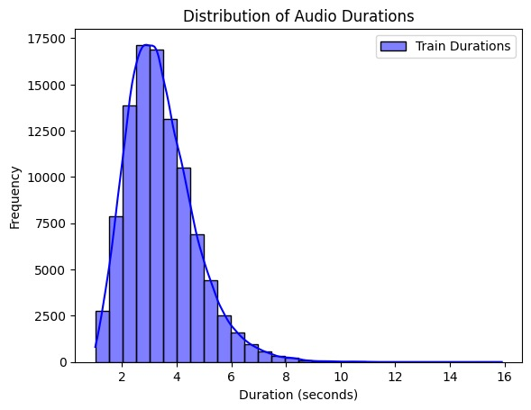
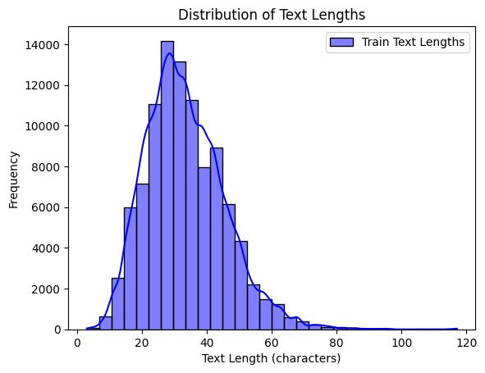
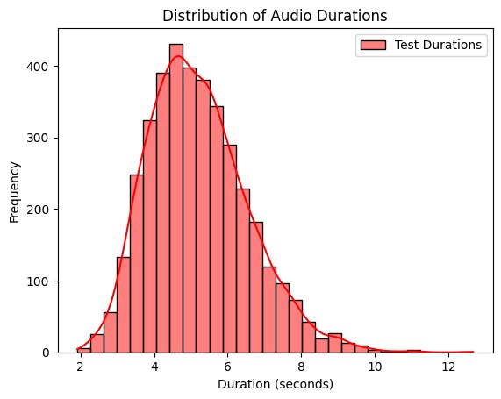
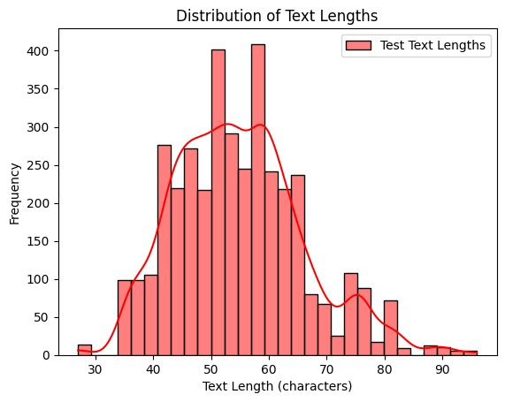
EDA
Train audio files: 99925
Train transcription entries: 99925
Test audio files: 3843
Test transcription entries: 3843

Slide 12
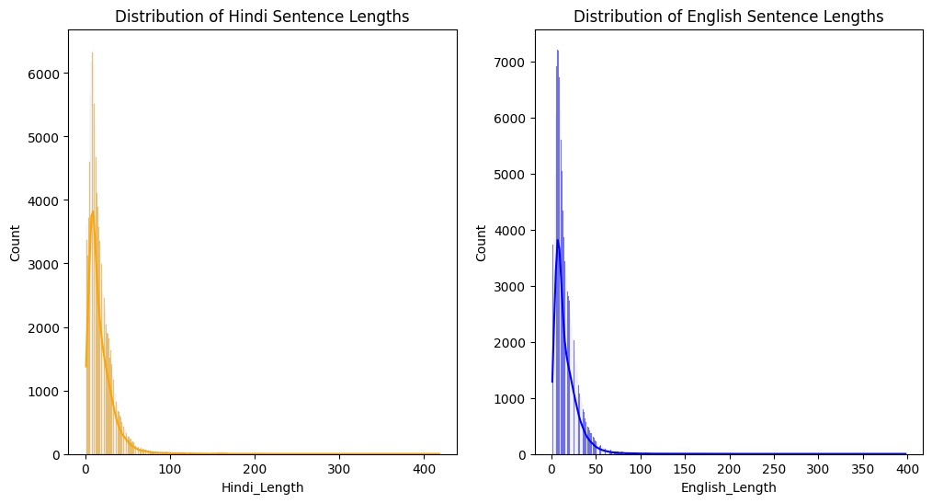
EDA of Corpus Data

Slide 13
PROPOSED METHODOLOGY
Automatic Speech Recognition (ASR)
Neural Machine Translation (NMT)

Slide 14
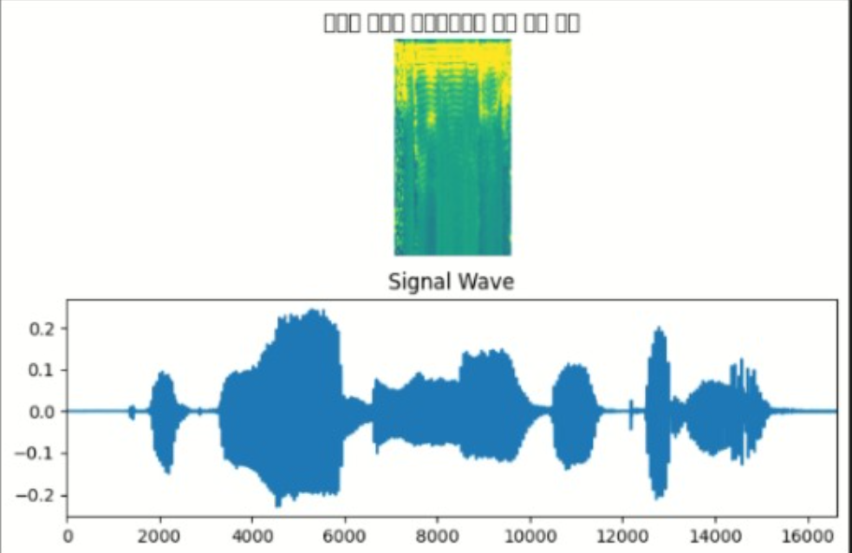
ASR - Data Preprocessing
Audio transformation (spectrograms using STFT)
It visually represents the frequencies of the audio signal over time.
In the first figure,
The x-axis represents time.
The y-axis represents frequency.
The colour intensity indicates the amplitude (louder sounds are brighter).
In the second figure,
The waveform of the same audio signal is displayed, which shows amplitude versus time.

Slide 15
ASR - Spectrogram formation
The audio waveform is split into small overlapping segments, called frames, using a sliding window technique.
The Fast Fourier Transform (FFT) converts each frame from the time domain to the frequency domain.
FFT produces a frequency spectrum, which is a vector of complex numbers representing the amplitude and phase of different frequencies within that frame.
For each frequency in the FFT output, compute the magnitude. This gives the power or strength of each frequency in the frame.
Magnitude spectra from all frames are stacked column-wise to create a 2D matrix. Rows represent frequencies, and columns represent time steps (frames).

Slide 16
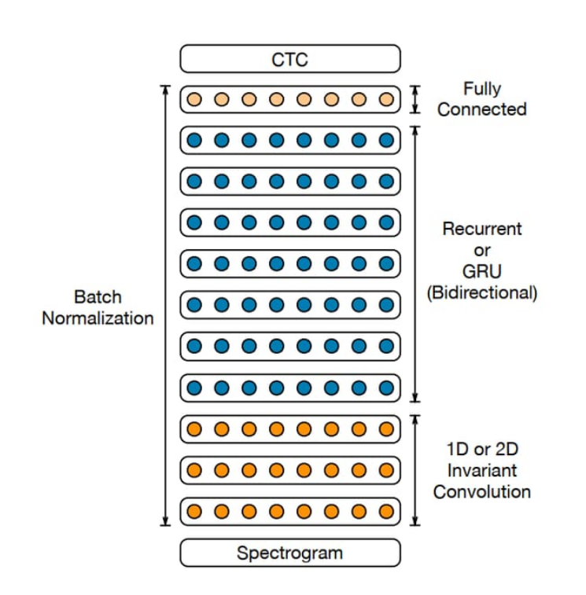
ASR – DeepSpeech2 Architecture
input layer processes spectrogram features.
2 Convolution layers extract temporal and frequency patterns:
Conv Layer 1: 32 filters, kernel size (11, 41), stride (2, 2).
Conv Layer 2: 32 filters, kernel size (11, 21), stride (1, 2).
Each convolution layer is followed by Batch Normalization and ReLU activation.
5 Bidirectional GRU layers process sequential data:
Each GRU has 128 units
Dropout (rate: 0.5) is applied after each GRU except the last one.
1 Dense layer with 128 * 2 = 256 units (due to bidirectionality).Followed by ReLU activation and Dropout (rate: 0.5).
1 Output Dense layer generates with a softmax activation.
The output probabilities are passed to the CTC loss function.
The CTC decoder aligns predictions with target sequences by collapsing repeated characters and removing blanks.

Slide 17

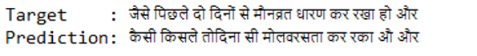
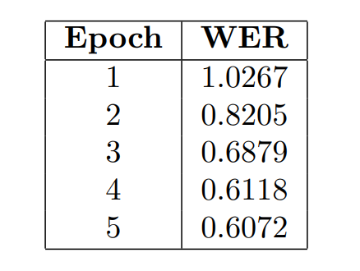
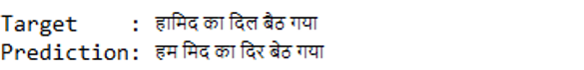
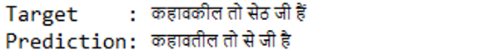
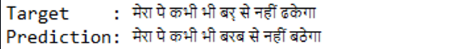
ASR – Speech2Text Results

Slide 18
NMT – Data Processing
Tokenization:
Builds Hindi (input_token_index) and English (target_token_index) vocabularies.
Adds START_ and _END tokens to English sentences for proper sequence decoding.

Slide 19
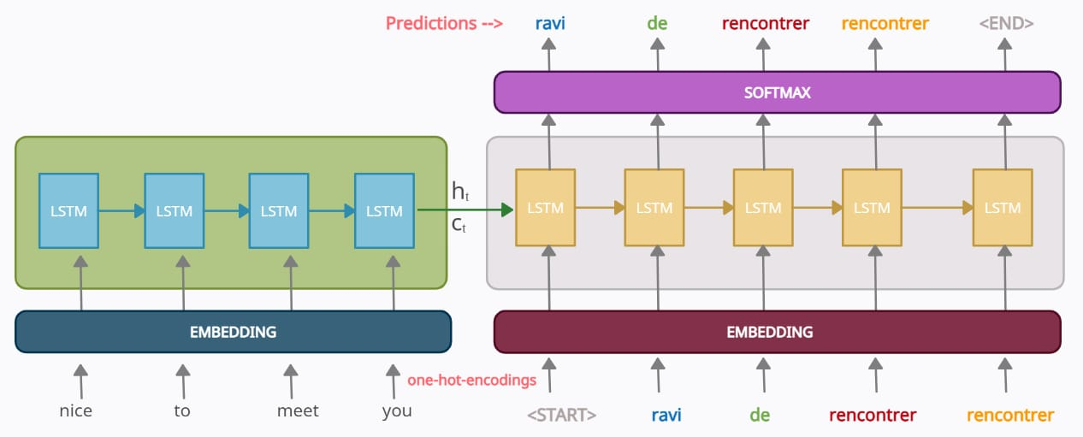
NMT - Seq2Seq Model Architecture

Slide 20
NMT - Seq2Seq Model Architecture
Encoder:
Input: Sequences of integers representing Hindi sentences.
Embedding Layer: Converts integers to dense vector representations.
LSTM Layer: Encodes input sequences into fixed-size latent representations & outputs encoder states and they are passed to the decoder.
Decoder:
Input: Sequences of integers starting with START_
Embedding Layer: Converts integers to embeddings.
LSTM Layer: Processes embeddings using initial encoder states.
Dense Layer: Generates probabilities for English vocabulary tokens with softmax.
Optimizer = ‘rmsprop’ & loss = ‘categorical_crossentropy’

Slide 21

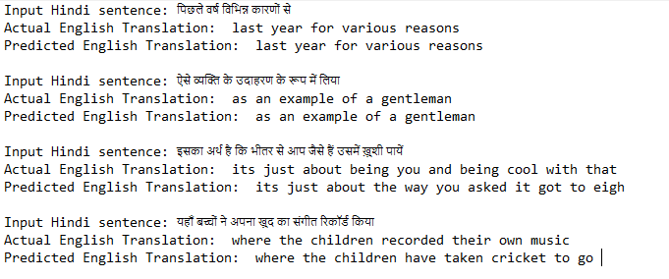
NMT - Results
Batch_size = 128
epochs = 100
Data | BLEU-1 | BLEU-2 | BLEU-3 | BLEU-4
Train | 0.76146 | 0.74229 | 0.74479 | 0.75243
Test | 0.187003 | 0.29371 | 0.38662 | 0.44772

Slide 22


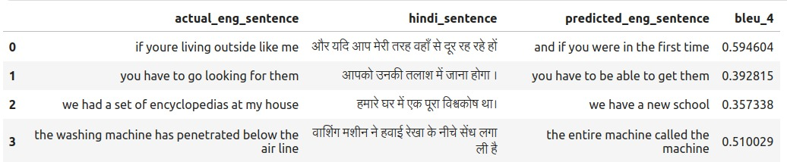
NMT – Results
Batch_size = 128
epochs = 100
with dropout rate = 0.2
Average BLEU Score on Test Data: 0.3902

Slide 23
Future Work
Plan to train the model for more epochs to improve accuracy and transcription quality.
Address Overfitting in Machine Translation
Work on improving generalization to avoid overfitting.
Model Deployment and Develop a User-Friendly Website

Slide 24
Thank you

Slide 25
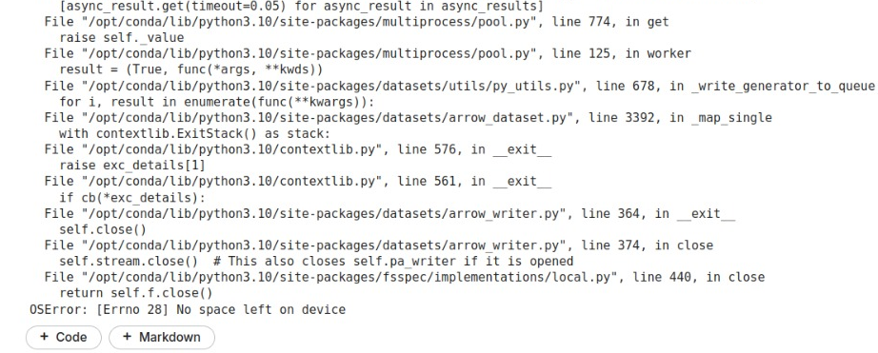
When Whisper Model applied

